Slide 1
Mercer Island
High School
Marching Band
Tournament of Roses
2019
Families and Students must sit together
Please fill the front seats first

Slide 2
Mercer Island High School Marching Band
Tournament of Roses 2019
Next several week’s schedule:
Uniform packing (everyone!) – Thursday, December 20th 3:30 to 5:30 p.m.
REHEARSAL - Thursday, December 20th 6:00 to 9:30 p.m.
REHEARSAL – Saturday, December 22nd 10:00 a.m. to 5:30 p.m.
REHEARSAL – Sunday, December 23rd 10:00 a.m. to 5:30 p.m.
Instrument packing (everyone!) – Sunday, December 23rd 5:30 to 6:30 p.m.
Fly-out – Thursday, December 27th at various times at Seatac
Arrive – Wednesday, January 2nd at various times at Seatac

Slide 3
Mercer Island High School Marching Band
Tournament of Roses 2019
Itinerary:
NO Diversions from the itinerary
Airport Protocol:

Slide 4
Mercer Island High School Marching Band
Tournament of Roses 2019
Itinerary:
Thursday 27 – Travel, LA Farmer’s Market, Fran Kick- Team Event
Friday 28 – Combined MI/BEG Rehearsal, Universal Studios
Saturday 29 – photo, floats, rehearsal, watch Band Fest, movie in Hollywood
Sunday 30 – Band Fest, watch Band Fest , Universal city walk
Monday 31 – Disneyland performance/time in the park
Tuesday 1 – Parade, banquet, Cars Land
Wednesday 2 - travel

Slide 5
Mercer Island High School Marching Band
Tournament of Roses 2019
Expectations:
We have been given the opportunity of representing Mercer Island, Washington State, The Pacific Northwest, and music education, to an enormous population. It is an expectation that we will honor this responsibility by acting as model ambassadors of these places, people and activities.
In order to do so, our mission will be to:
Move through our experience with humility and gratitude
Demonstrate a genuine appreciation for the unique skills, cultures, and presentations of other participants
Celebrate the gift that has been given to us by our community by performing to the very best of our ability.

Slide 6
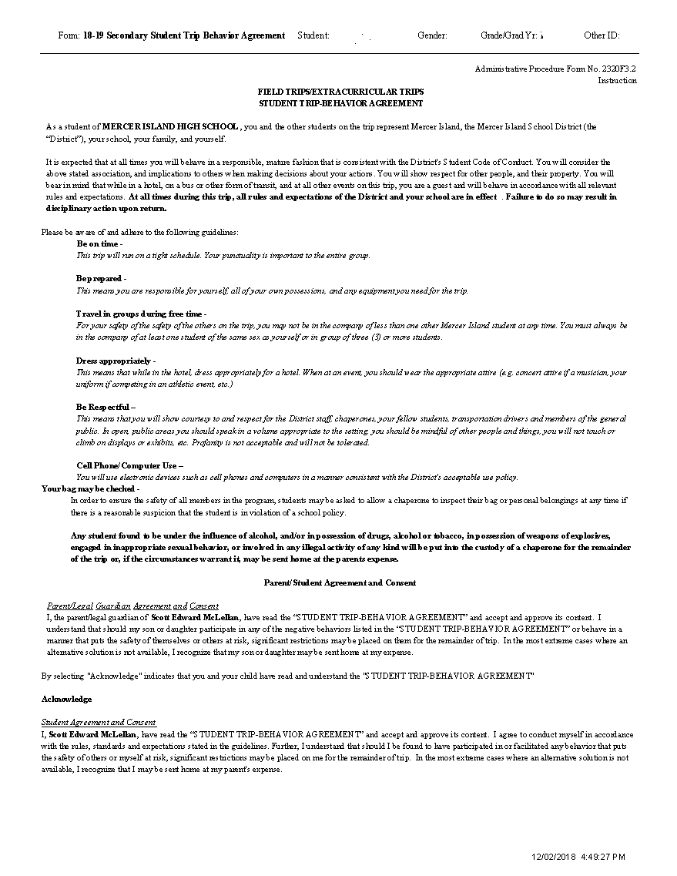
Mercer Island High School Marching Band
Tournament of Roses 2019
Expectations:
Be on time
Be prepared
Travel in groups during free time
Dress appropriately
Be respectful
Cell phone/computer use
Inappropriate behavior: alcohol,
drugs, sexual, tobacco,
weapons, etc. – student will
be sent home at parent’s expense
Students may not gather in a room other than their own assigned room, for any reason, without prior permission of a Director or Chaperone.

Slide 7
Mercer Island High School Marching Band
Tournament of Roses 2019
Packing List (everyone limited to one luggage carry-on and a backpack/bag):
Government-issued ID for TSA (18+)
Temps range from 45 – 80 degrees
Black socks, black band shirt, leggings, shorts
Travel wear – jacket, tshirt
Casual clothes – for travel, parks, touring
Sleepwear
Pack tightly please
(a detailed list will be emailed tonight)

Slide 8
Mercer Island High School Marching Band
Tournament of Roses 2019
Instrument/Uniform packing plan:
Uniforms
Into garment bags - December 20th
Loaded onto trailer by volunteers later
Instruments
Loaded onto the rental truck immediately after winter rehearsal on Sunday, December 23rd
Unloaded from truck on January 4th

Slide 9
Mercer Island High School Marching Band
Tournament of Roses 2019
Chaperone Groups:
Posted in Commons
Flight groups, room groups, bus groups remain the same for the week

Slide 10
Mercer Island High School Marching Band
Tournament of Roses 2019
Drop off/Pick up plan, flight groups:
Meet at Seatac at listed time
Find chaperone
Flight groups/drop off time posted in Commons
Pick-up at Seatac on January 2nd
Release to names of adults in Skyward unless we receive an email with specific pick up instructions

Slide 11
Mercer Island High School Marching Band
Tournament of Roses 2019
Health recommends prior to the trip:
Wash hands
Wash hands
Wash hands
Sleep
Sleep
Sleep

Slide 12
Mercer Island High School Marching Band
Tournament of Roses 2019
Medical plans in California:
We are traveling with two designated chaperones as medical professionals
Illness – isolate and treat
Injury – L.A. resources
Permission slip allows treatment but parents will be contacted asap

Slide 13
Mercer Island High School Marching Band
Tournament of Roses 2019
Emergency contacts:
Email
Kyle.Thompson@mercerislandschools.org
Parker.Bixby@mercerislandschools.org
Brian.Lawrence@mercerislandschools.org
Jen.McLellan@mercerislandschools.org
Jen’s cell phone 206.890.0628

Slide 14
Mercer Island High School Marching Band
Tournament of Roses 2019
Where to watch us:
Direct link via Tournament of Roses website: https://tournamentofroses.com/broadcast-partners/

Slide 15
Mercer Island High School Marching Band
Tournament of Roses 2019
Next steps this evening:
Find your chaperone
Thank them!
Pick up your travel-wear
Write your names in each item
Safely store them (parents)
Head to rehearsal

Slide 16
Mercer Island High School Marching Band
Tournament of Roses 2019
Thank you to each of our students for working so hard for this last 14 months
Thank you to our parents for saying ‘yes’ to everything! Volunteering, fundraising, driving and supporting your child
Thank you to this community for believing in Arts education for our island children

